Slide 1
How Good are you at Managing your Processes?
Operational Excellence

Slide 2
Many processes are often organically created to meet immediate needs.
Organisations have found it difficult to maintain and control their own processes.

Slide 3
Regulatory, auditing and legal concerns are now moving from data to business processes.
Many standards now exist which are process based and set an expectation for business operation.
Regulation such as BASEL II, or Sarbanes Oxley now focuses on procedural concerns not data.

Slide 4
Do you have a thorough understanding of the work you’re managing?

Slide 5
Do you understand how your business works?
Managers are often unaware of how their work relates to other parts of the business.
A process map helps all employees to work together and break down department barriers, bringing teams together in a productive way.

Slide 6
Do you understand your customer’s experience?
Processes produce a customer experience.
What is the customer’s perception of value provided.
Broken processes are likely to lead to unhappy customers.

Slide 7
Do you measure performance?
By building well-developed business processes, goals and standards will be more attainable.
Employees will be more engaged.

Slide 8
Do people understand and receive training on processes?
A process provides the foundation for how work gets done.
Valuable knowledge is documented and employees can be trained quickly and effectively.

Slide 9
Two organisations with the same services, the one that is operationally excellent will be more successful.
You must develop process management capabilities to improve and survive in today’s world.

Slide 10
One way to understand your capabilities and improve is by performing a Business Process Management Maturity (BPMM) review

Slide 11
What a BPMM Review entails
Review of your current process practices.
Assessment of Six critical factors.
Identify the level of required competency of each factor at each level of process maturity.
Assess your capacity for change.
Tailor assessments to consider customer views and industry sector.
Perform within a fixed time box to control costs.

Slide 12
Benefits of BPMM Review
Provide a clear assessment of your current level of capability.
Identify your organisations strengths and weaknesses.
Help you to decide where best to direct strategic investment.
Provide a benchmark prior to initiating any strategic programs of business improvement.

Slide 13
The review helps you to set targets and expected behaviours to aspire to and to improve your business process management capabilities.

Slide 14
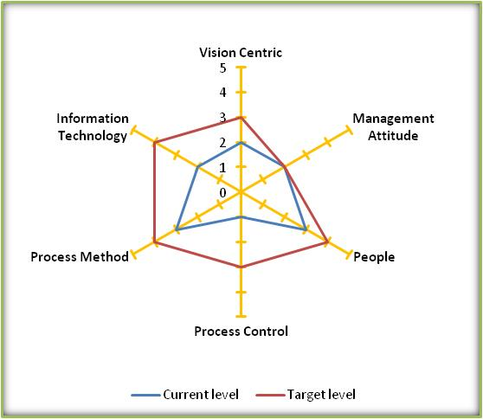
A Visual Measure of 6 BPM factors
Gives an assessment of current and target maturity levels.
Plus an ability to change rating for each factor (given in brackets).
(60%)
(90%)
(100%)
Maturity level Score is 1 to 5 where:
5 is Adaptable
4 is Reliable
3 is Standard
2 is Stable
1 is Initial
(70%)
(40%)
(90%)

Slide 15
How to approach a BPMM Review
Build the BPM Review charter
Elementary Business Process Inspection Stage
Consolidate Business Process Exploration Stage
Produce and Present Findings
Reflect on Discoveries
Typical timescales for the review process depending on the scope of the review:
Small business unit review
2 Weeks
Single location enterprise review
1 month
international or multi site organisation
2 months

Slide 16
BPMM Review – the steps
Build the BPMM Review Charter
Preliminary Business Process Inspection stage
Reflect on the Discoveries
OBJECTIVES | At this stage we will engage with you to understand what you want to achieve from the review and establish the extent of the review | A comprehensive first look at the six dimensions for process management. | To focus efforts on areas of importance to your business after preliminary look.
ACTIVITIES | Talk with yourselves to identify the key or stakeholders and report recipients Understand the senior management team’s attitude to BPM, understanding of BPM, and perceived current level of business process management capability. Identify specific tailoring of the review to specific standards or regulatory needs. Appoint a Business Process Champion we can work with. Talk to stakeholders about aims | Process documentation Management and governance of processes Benchmarking and KPIs of processes Alignment of organisational structure and roles to processes. IT systems alignment to processes Customers perception of processes Personnel skills and knowledge of processes | We will engage with your Business Process Champion and other stakeholders to consider what has been discovered and what merits further investigation. The Business Process Champion’s knowledge of your organisations is important for getting the most from this. Your organisation retains control of the review process and you have this opportunity to redirect efforts and focus on specific priorities which you see as important to your business.
DELIVERABLES | BPMM Review Charter | Review Capability checklist Fact finding research One to one Interviews | Revised plan
1
1

Slide 17
BPMM Review – the steps
Consolidate Business Process Exploration stage
Produce and Present BPM review report
OBJECTIVES | Closer inspection on areas agreed with the Business Process Champion. | we will engage with the Business Process Champion to ensure that he/she is satisfied with the accuracy of the findings and to tailor the report to provide your stakeholders with a meaningful report.
ACTIVITIES | To consider a specific dimension (e.g. Culture and Leadership). Investigate a specific business area (e.g. process management within HR). For the more process mature organisations, we can consider process improvement capability review looking at the application of improvement methods such as Lean and Six Sigma. Etc. | The BPM review report will be a frank and insightful assessment of your organisation current BPM maturity level and capabilities. The review will revisit the Management’s initial view of the current level of maturity and the different perceptions between management and current operation (the business lag effect).
DELIVERABLES | Fact finding research One to one Interviews | The Business Process Maturity Level assessment The Business Process Maturity review report
2
3
Notes:
The BPM review report will be a frank and insightful assessment of your organisation current BPM maturity level and capabilities. The report will give some possible practical and realistic ways to improve your organisations capabilities. Improvements that will bring benefits to your organisation and which are required to move up the Gartner Business Process maturity model levels.

Slide 18
Key Deliverables
 | The Business Process Management Maturity Review Charter | The charter is the start up document for the review and covers: Business areas within scope of the review. Timeframe for completion of the review. The business priorities, concerns and aims for directing the review focus. Your Management’s initial view of the current level of maturity. Protocols and conduct for ensuring security and confidentiality of information and views provided during the review. Specific tailored options to be included in the review.
 | Business Process Maturity level Assessment | A simple and easy to communicate statement of the current level of Business Process maturity on the Business Process Maturity Model.
 | The Business Process Maturity Review Report | An extensive report of the current business process management covering Six dimensions of capability Plus customer views Plus Sector comparisons, regulatory or guidance compliance (if included) Identifying current capability gaps Provide practical pointers to improve BPM maturity based upon my extensive experience of BPM.

Slide 19
Typical action plan (single location)
 | Week 1 |  |  |  |  | Week 2 |  |  |  |  | Week 3 |  |  |  |  | Week 4
Build BPM Charter
Management Assessment
Identify stakeholders
Document charter
Plan reviews
Preliminary Inspection Stage
Review Operational processes
Review methods and systems
Design Questionnaire
Gather customer views
Gather staff views
Review Preliminary Findings
Consolidate Business Exploration
Detailed reviews or interviews
Best practice/Sector views
Develop output
Produce BPM maturity level
Produce BPM Review Report
Present Findings
Prepare and review findings
Present recommendations & next steps

Slide 20
BPMM Review Summary Sheet
Summary Sheet
A short fixed period and targeted review exercise.
The BPM Review is a collaborative review process engaging with your management to understand your concerns and aims for the review.
The review covers all aspects relating to BPM:
Vision & Steering
People
Management Approach
Process Control
Process Methods
Technology
Capable of tailoring the BPM maturity review to consider;
Customer views
Entire enterprise wide review or specific divisions
Industry sector practice
Specific process regulation or best practice guidance
Provides clearly defined and understood level of maturity in form of a Business Process Maturity Model.
A clear and frank assessment of your current level of Business process maturity.
A statement of current business process management capability.
Key points for improving BPM maturity for consideration in future strategy planning for process improvement.
Agility rating provides a probability of achieving the target level.

Slide 21
“Helping Businesses and People to Change.” Contact: Rob Topley https://uk.linkedin.com/in/rtopley +44 7469 760897

