Slide 1

CHANGE READINESS ASSESSMENT
Measuring stakeholder engagement and attitude to change

Slide 2

Change and People Engagement
Research shows that over the last 40 years the failure rates for IS & IT based projects have been consistent at around 70%¹,
& the failure rates for major business change projects remain around 66%².
¹ Ward & Daniel (2006)
² McKinsey & Company (2008)

Slide 3

Many of the key reasons for failure are related to the level of engagement and people’s response to changes.

Slide 4
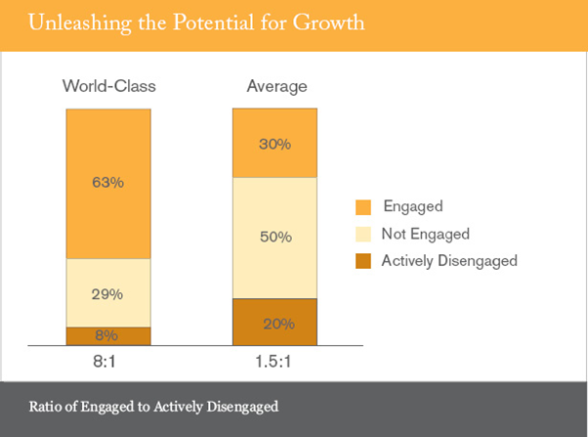
Change and People Engagement
Market leading organisations have a greater level of employee engagement and involvement in change (Gallup).
http://www.gallup.com/businessjournal/163130/employee-engagement-drives-growth.aspx

Slide 5
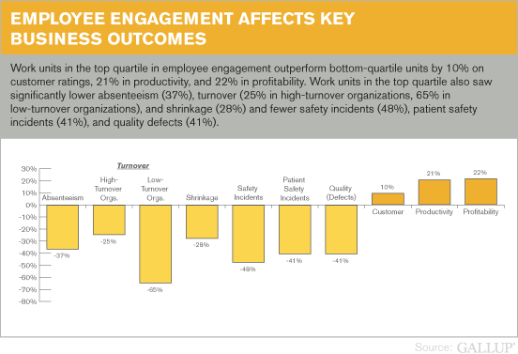
Change and People Engagement
Changes come from individuals & teams changing what they do, & how they do it.
http://www.gallup.com/businessjournal/163130/employee-engagement-drives-growth.aspx

Slide 6

One of the most common ways to measure attitude to change, is using a Change Readiness Assessment (CRA).

Slide 7
A CRA will:
Determine the readiness of the organisation to deliver change & sustain benefits.
Provide analysis of the areas that are supportive/resistant, & to what degree.
Inform the targeting of actions to optimise readiness & enable the achievement of sustained benefits.
Enable readiness to be tracked, & monitor improvements to achieve change readiness.

Slide 8
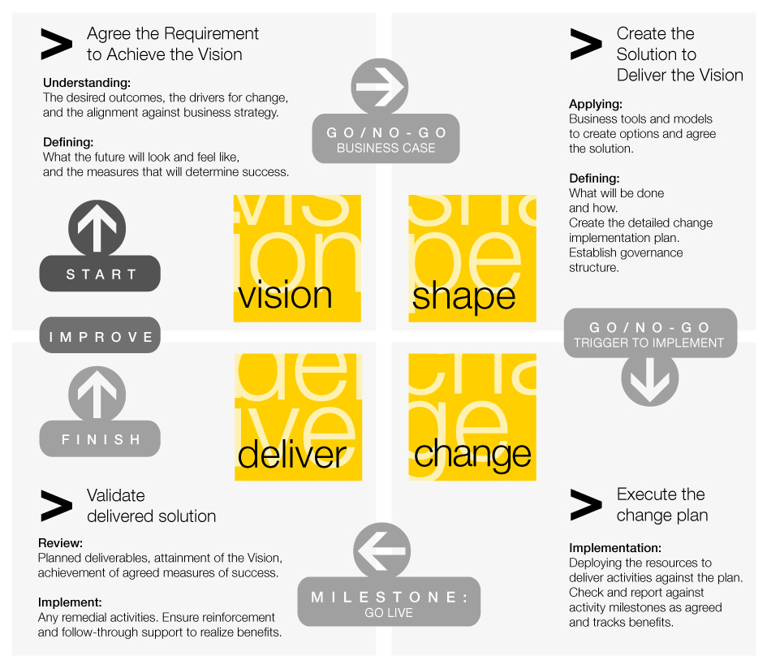
CRA in the Change Lifecycle
Strategy Implementation
The initial Change Readiness Review should be performed early in the lifecycle
Business Strategy & Goals
Set Out: the requirements to achieve the vision
Target: create the solution to deliver the vision.
Delivery of Business Strategy & Goals
Alter:
deliver the changes, deploying resources and altering operations
Reassess in later stages to measure improvement in readiness & attitudes
Refine: validate the solution, measure results and exploit further opportunities

Slide 9
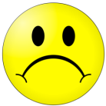
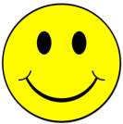
CRA in the Change Lifecycle
Run a CRA at different times and compare results.
You are looking for a shift from to
CRA allows you to:
  Understand the impact of any actions taken and the change in attitude as your project progresses.
  Take action if engagement is not sufficiently high enough and brings risk to the change.

Slide 10
CRA - Dimensions
The CRA content and form varies for each organisation and change but is likely to cover:
Willingness
Assesses Attitudes & Behaviour towards the change
Capability
Assesses Leadership, Processes, skills and tools to deliver change
The Change
Assesses Solution Acceptance, product function etc
Readiness at different organisation Levels
Organisation
Assesses Organisational readiness
Department /Groups
Assesses readiness of departments/groups
Individual
Assesses personnel readiness

Slide 11

How to approach a CRA?
Understand Client & Change Scope
Identify stakeholders to be contacted
Plan assessment & select methods
CRA Plan
Customise/ Compile Questions
Survey & Interview Questions
Gather Data & Conduct Interviews
Further validation & investigation
Survey Data
CRA Report
Interview notes
Yes
Analyse Findings
Produce Report & Present Results
CRA Complete
Clarify Findings?
Risk Register

Slide 12
CRA – The steps
CRA Planning
Gathering Data
Analysing & Reporting
OBJECTIVES | Prepare the assessment process. | Determine the readiness of stakeholders to implement the change & deliver sustainable benefits. | Provide analysis of the areas that are aligned or supportive, & to what degree & inform the targeting of actions to optimise readiness & enable the achievement of sustained benefits
ACTIVITIES | Agree with Sponsor(s): assessment frequency / scope / confidentiality / timeframe Communications from sponsor to business Agree logistics for running on-line assessment tool Creation & signing off supporting interview scripts Agree outline of final report formats Identify & meet main stakeholders in the business Arrange change assessments | Conduct On-Line Change Readiness Assessment, & supporting sample interviews Conduct risk assessment to support the change process (using our unique Excel-based tool) Periodic checkpoint assessments of stakeholder support through implementation lifecycle of the change effort Identify during interviews, potential future change champions (& also significant change blockers) Identify full scope of drivers that will inform a go/no-go decision | Analyse results of on-line assessment process, supporting interviews, & risk assessment Create written report of findings & conclusions Share findings with sponsor(s) & other key stakeholders in the business Share findings with others involved in change effort as results may show their activities need to change in some areas Create rolling action plans to manage problem areas, & mitigate risks
DELIVERABLES | Change Readiness activities project plan Timetable for assessments & associated interviews Initial stakeholder analysis of key stakeholders in the business | Change Readiness Assessments Ongoing key stakeholder assessment Potential change champions, in the business, (hearts & minds support) Readiness for go/no-go decision | Report & analysis Readiness of ‘go/no-go’ status Recommendations to inform other areas of the change effort, e.g. Comms & Training, and to sustain changes in the future

Slide 13
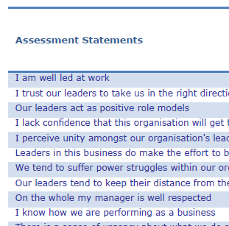
Key Deliverables
 | Change Readiness Assessment Plan | Defines the scope of the assessment, the individuals to be assessed and the different methods of assessment to be used.
 | Change Readiness Assessment Scripts | The design of the script is pivotal to the quality of information gained. It contains both statistical & narrative questions which serve to give feedback, for example, on the respondents' understanding of the change effort; the degree to which they feel involved & motivated to support the change; their training & communications needs.
 | Report to Sponsor(s) | The report will include a mix of statistical & narrative analyses Our Change Readiness Assessment process brings together the expertise of our consultants, the details of your change, and change capabilities to determine readiness for successful change. It shows graphically the degree of readiness (or un-readiness) against a range of factors. Recommendations are offered to highlight activities to enhance engagement or sustain current areas of existing engagement.

Slide 14

Case Studies

Slide 15
Environment Agency
What are the client challenges?
  The Environment Agency flood warning service. Was an ageing service using old technology (telephone and pager). The service needed replacing and subscribers of the service were too few. The aims were:
  to increase the public awareness and take up of receiving flood warnings.
  To improve and standardise the quality of flood warning across England and Wales while still retaining a local perspective.
  Reduce the operating costs and indirectly the impact of flooding.
  CRA in the form of interviews, surveys and focus groups allowed us to measure and track:
    Regional EA staff attitude to a new centralised system.
    Public attitude to a flood warning service and adopting new channels and message styles.
    Media and Emergency services acceptance of new ways of sharing flood information.
How did we address the challenge?
What were the benefits to the client?
  CRA enabled the EA to better manage communications efforts with all the different parties involved.
  CRA helped identify solutions components that needed changing.
  CRA allowed efforts to be focused in the areas where resistance was greatest and most critical for the success of the project.

Slide 16

“Helping Businesses and People to change.”
For further information contact:
Rob Topley https://uk.linkedin.com/in/rtopley rob.topley@btinternet.com
+44 7469 760897

